Slide 1




Hexaware CODE&RISE PROGRAM
MIND HACK
CODE WITH PURPOSE,CREATE WITH PASSION

Slide 2
Team Details
MIND HACK
Soft Skills Enhancement Application
Team Members
Email ID
Savitha
…
…
…
…
…
…

Slide 3
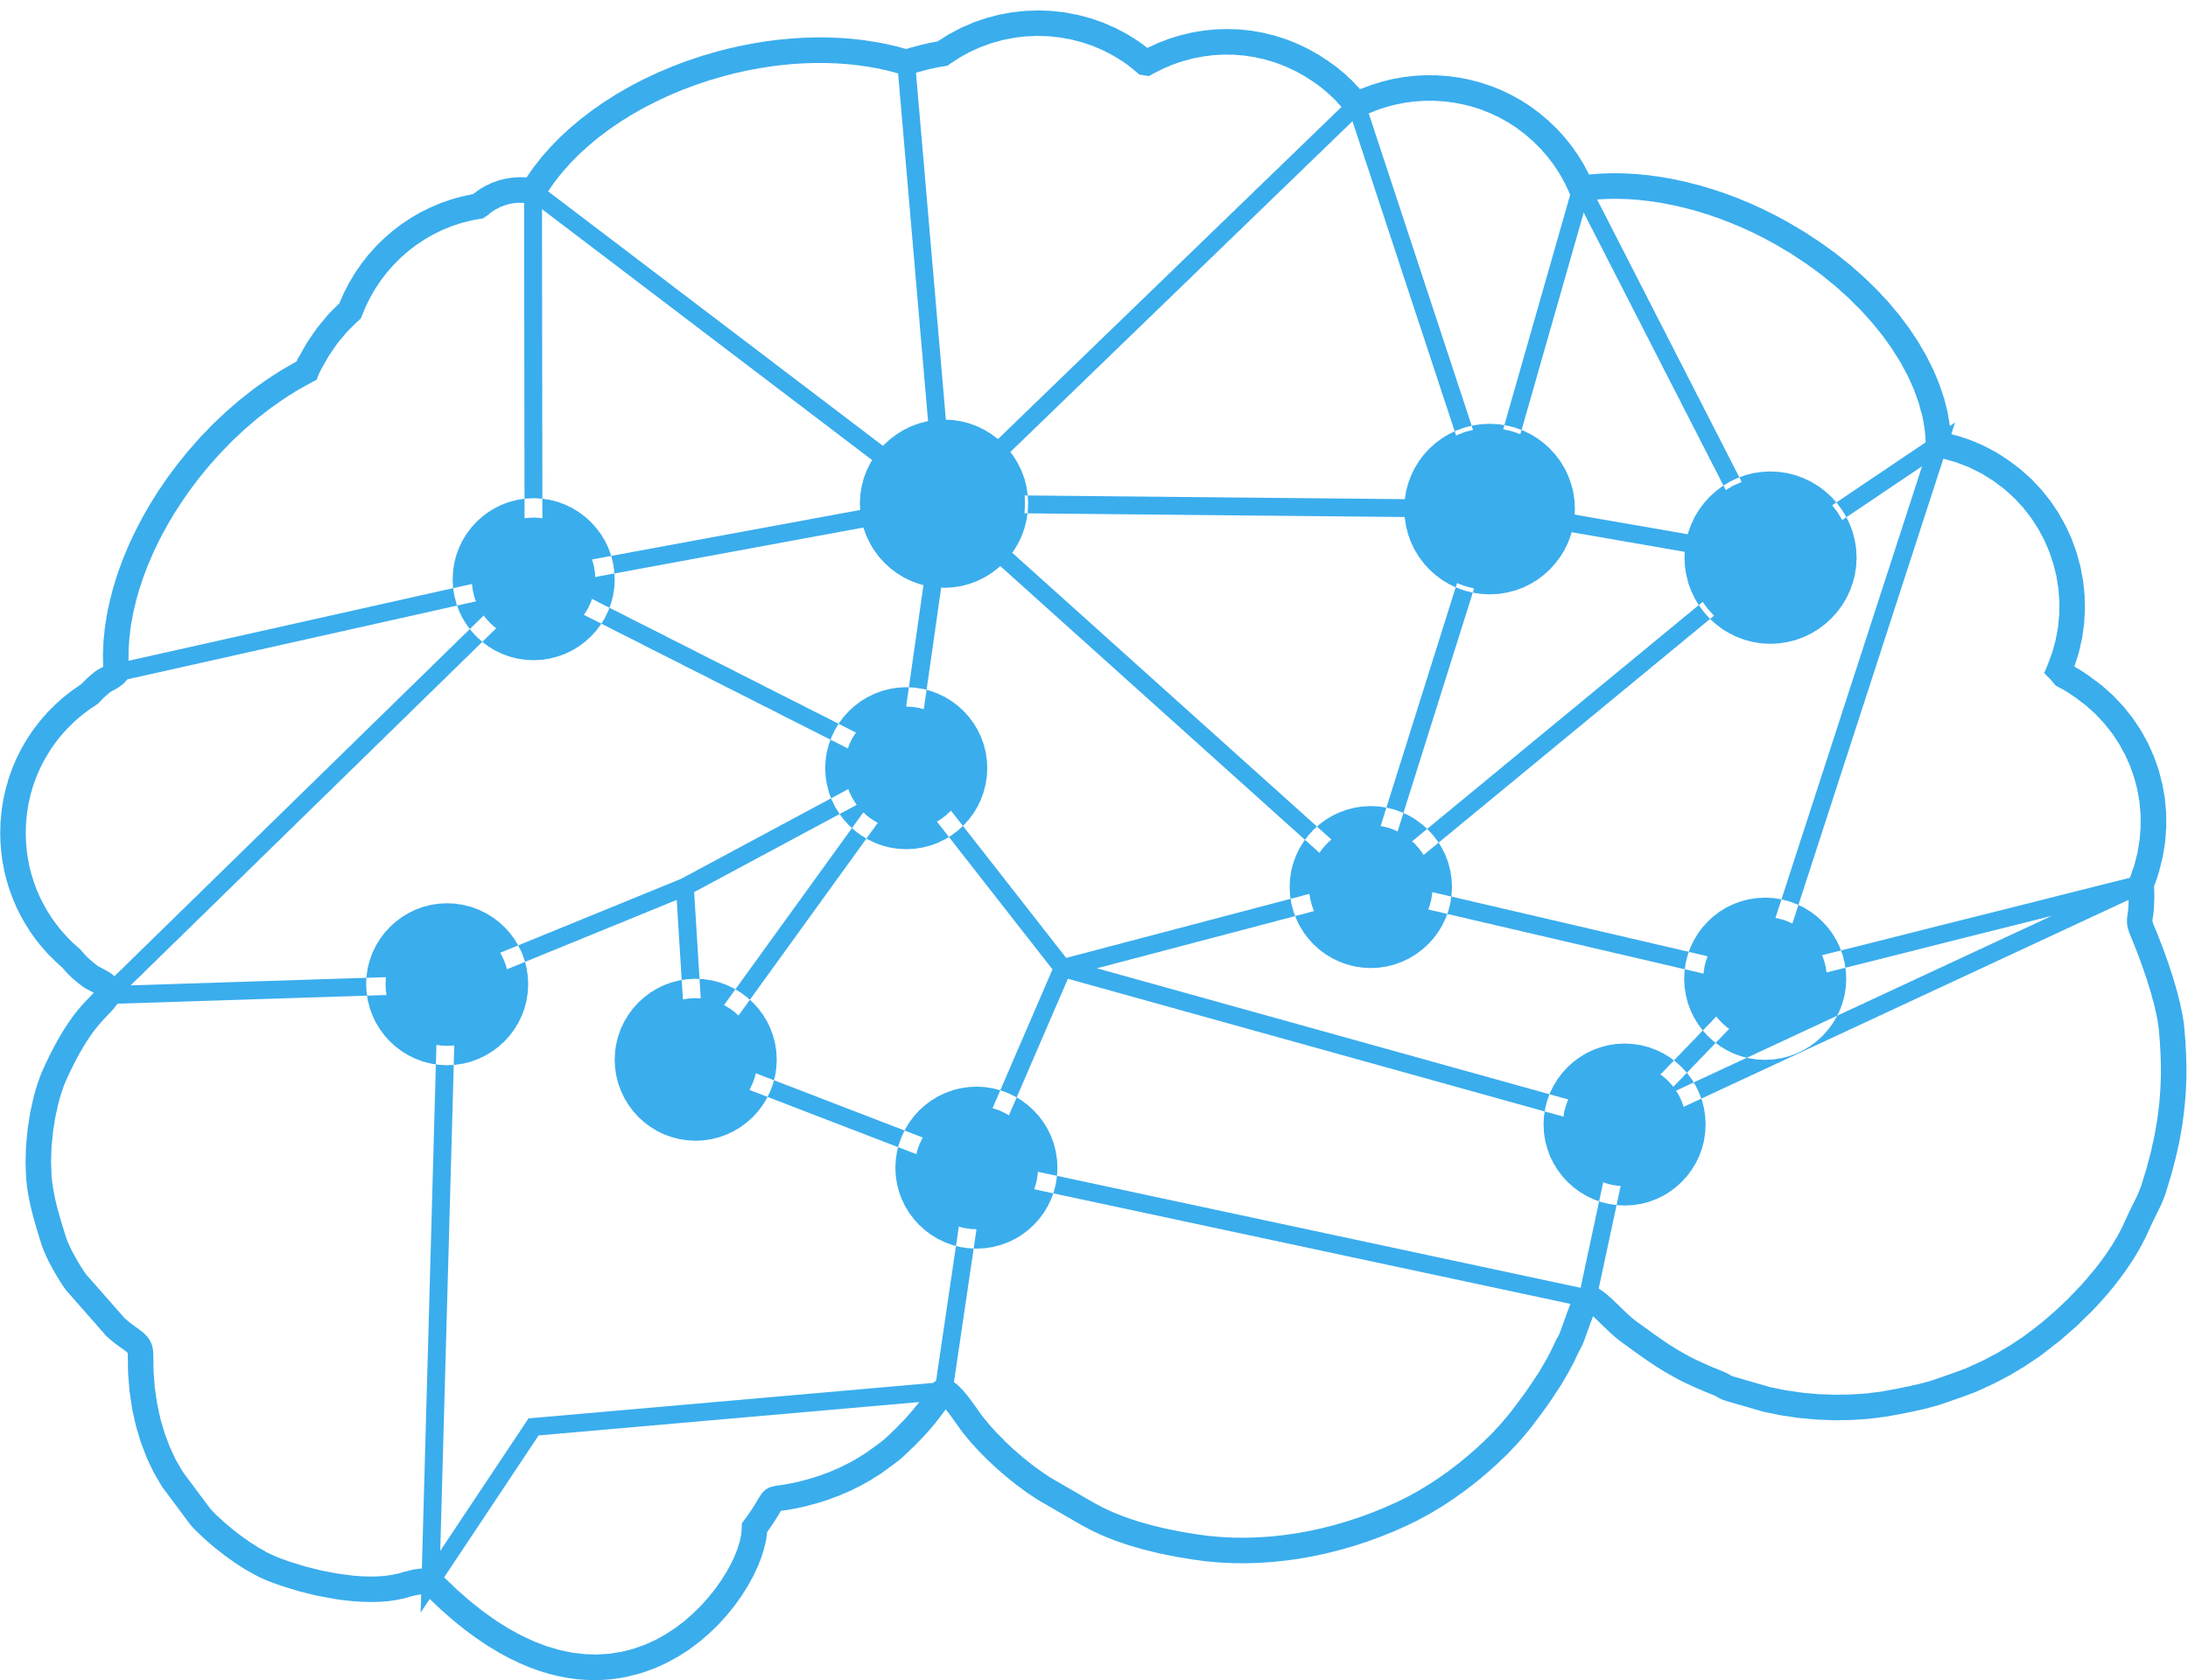
Impact/Potential Value of the Soft Skills
Enhancement Application
The potential value of a soft skills enhancement application is vast and far-reaching. By improving communication, leadership, time management, and other essential soft skills, individuals can experience increased self-awareness, boosted career prospects, and enhanced teamwork and collaboration. This can lead to better leadership, improved customer service, increased productivity, and reduced conflicts. Additionally, developing skills like stress management, self-care, and emotional intelligence can lead to improved mental health and well-being. Overall, a soft skills enhancement application can give individuals a competitive edge in the job market, leading to personal and professional growth, and ultimately, success. By investing in soft skills development, individuals can unlock their full potential and achieve their goals, leading to a more fulfilling and purposeful life.

Slide 4
The Solution Proposed by your Team
Solution Highlights
Key Features / Approach
A soft skills enhancement application offers a personalized and engaging experience, tailoring learning paths to individual needs and goals, with adaptive assessments and recommendations. Interactive modules feature video lessons, gamified exercises, and real-world scenarios to practice soft skills, while AI-powered coaching provides personalized feedback and guidance. Social learning connects users with peers for discussions and shared experiences, and real-time feedback tracks progress and identifies areas for improvement. Microlearning ensures continuous learning in bite-sized lessons, and gamification makes the experience fun and motivating. Comprehensive 360-degree assessments and customizable options align with individual, team, or organizational goals, with measurable ROI and actionable insights for continued growth.
A soft skills enhancement application features personalized learning paths, interactive modules with video lessons and gamified exercises, AI-powered coaching, social learning, real-time feedback, microlearning, gamification, 360-degree assessment, customization, and analytics. The approach is user-centered, scientifically-backed, flexible, adaptable, storytelling, spaced learning, social, collaborative, continuously improving, data-driven, accessible, and inclusive. The application is designed to engage and motivate users, using real-world examples, gamification, and incentives to encourage learning and development. It accommodates different learning styles, tracks progress, measures ROI, and identifies areas for improvement. By leveraging these features and approaches, the application provides an effective and comprehensive solution for developing essential soft skills, leading to personal and professional growth, improved performance, and increased success.

Slide 5
Technologies Used
JavaScript
Python
HTML/CSS
React Native
Node.js
Java
PHP
Ruby
TypeScript
Angular

Slide 6
Gen AI Tool Utilization
Chatbots: Automated coaches that offer personalized feedback and support.
Sentiment Analysis: Emotion detection to provide tailored feedback.
NLP: Analyses communication skills and suggests improvements.
Predictive Analytics: Predicts behaviour and recommends personalized learning.
Personalized Recommendations: Suggests relevant content based on user behaviour.
Automated Feedback: Instant feedback on user performance.
Social Learning: Connects users with peers or mentors for social learning.
Emotion Recognition: Detects emotions to improve emotional intelligence.
Content Generation: Creates personalized training content.
Progress Tracking: Tracks user progress and identifies areas for improvement.

Slide 7
System Architecture, Functionalities and Design Diagram
Design Diagram:
System Architecture:
User Interface (Mobile/App/Web)
Application Server (Backend)
Database (User Data, Content, Analytics)
API Gateway (Integration with third-party services)
Machine Learning Server (AI-powered features)
User Interface
Application Server
Functional Components:
User Management (Authentication, Profile Management)
Content Library (Videos, Articles, Quizzes, Games)
Learning Paths (Personalized skill development plans)
AI-powered Coaching (Chatbots, Sentiment Analysis)
Social Learning (Forums, Groups, Mentorship)
Database
Machine Learning
Content Management

Slide 8
How it works
Functional Architecture
User Management - Authentication - Profile management - Baseline assessment
Content Management - Content library (videos, articles, quizzes, games) - Content creation and updates - Content recommendation engine
AI-Powered Coaching - Machine learning algorithms - Natural language processing (NLP) - Sentiment analysis - Personalized feedback and guidance
Learning Path Management - Personalized learning plans - Learning path creation and updates - Progress tracking and feedback
Social Learning - Group and discussion forum management - Mentorship and connection facilitation - Social learning analytics
Gamification - Point and badge systems - Leaderboards and progress tracking - Engagement and motivation analytics
Analytics and Feedback - User progress and performance analytics - Feedback and assessment tools - AI-powered insights and recommendations
Integration - Third-party API integrations (e.g., calendar, email) - Data import and export gagement and motivation, while the analytics and feedback components provide insights and assessment tools. capabilities

Slide 9
How It Works
Technical Architecture
Frontend - Client-side framework (e.g., React, Angular) - User interface components (e.g., HTML, CSS, JavaScript) - Responsive design for web and mobile
Backend - Server-side framework (e.g., Node.js, Django) - API design (e.g., RESTful APIs) - Business logic and data processing
Database - Relational database management system (e.g., MySQL) - NoSQL database (e.g., MongoDB) - Data modeling and schema design
AI/ML Engine - Machine learning framework (e.g., TensorFlow, PyTorch) - Natural language processing (NLP) library (e.g., NLTK, spaCy) - Sentiment analysis and emotion detection
Content Management System (CMS) - Headless CMS (e.g., Strapi, Ghost) - Content creation and management - API-based content delivery
Authentication and Authorization - Authentication framework (e.g., OAuth, Okta) - Role-based access control (RBAC) - User permissions and access management
Integration - Third-party API integrations (e.g., calendar, email) - Data import and export capabilities - Webhooks and event-driven architecture
Infrastructure - Cloud hosting (e.g., AWS, Azure) - Containerization (e.g., Docker) - Scalability and performance optimization

Slide 10
Innovation and Creativity
Gamified Learning Paths: Use gamification elements like points, badges, and leaderboards to make learning soft skills engaging and fun.
AI-powered Coaching: Implement AI-driven personalized coaching that offers real-time feedback and suggestions.
Social Learning Platform: Create a social network for users to connect, share experiences, and learn from each other.
Immersive Storytelling: Use interactive stories, videos, or virtual reality to simulate real-life scenarios and teach soft skills.
Personalized Avatars: Allow users to create personalized avatars that represent their skills and progress.
Real-time Feedback Tools: Offer instant feedback and assessment tools to help users identify areas for improvement.
Mentorship Programs: Connect users with experienced mentors for guidance and support.
Soft Skills Analytics: Provide detailed analytics and insights on users' soft skills progress and strengths.
Customizable Learning Plans: Allow users to create tailored learning plans based on their needs and goals.
Integration with Wearable Devices: Incorporate wearable devices to track users' emotional intelligence and soft skills in real-time.

Slide 11
Scalability, Performance and Security
Scalability:
Microservices Architecture: Use a microservices architecture to allow for scalability and flexibility.
Cloud Hosting: Host the application on a cloud platform to enable easy scaling.
Load Balancing: Use load balancing techniques to distribute traffic and ensure high availability.
Auto-Scaling: Implement auto-scaling to automatically adjust resources based on demand.
Database Sharding: Use database sharding to distribute data and improve performance.
Performance:
Optimize Code: Optimize code for performance and efficiency.
Caching: Implement caching mechanisms to reduce latency.
Content Delivery Network (CDN): Use a CDN to distribute static content and reduce load times.
Database Optimization: Optimize database queries and indexing for faster data retrieval.
Monitoring and Analytics: Use monitoring and analytics tools to identify performance bottlenecks.
Security:
Authentication and Authorization: Implement robust authentication and authorization mechanisms.
Data Encryption: Encrypt sensitive data both in transit and at rest.
Access Control: Implement role-based access control to restrict access to sensitive features.
Regular Updates and Patching: Regularly update and patch the application to address security vulnerabilities.
Penetration Testing and Security Audits: Conduct regular penetration testing and security audits to identify vulnerabilities.

Slide 12
Best practices and industry standards followed
User-Centered Design: Follow user-centered design principles to create an intuitive and engaging user experience.
Gamification: Incorporate gamification elements to make learning soft skills enjoyable and interactive.
Personalization: Use AI-powered personalization to offer tailored learning paths and content.
Social Learning: Incorporate social learning features to enable collaboration and knowledge sharing.
Mobile Optimization: Ensure a seamless user experience across various devices and platforms.
Accessibility: Follow accessibility guidelines (WCAG 2.1, ADA, etc.) to make the application inclusive.
Data Analytics: Use data analytics to track user progress, identify areas for improvement, and evaluate effectiveness.
Security and Privacy: Adhere to industry standards (GDPR, HIPAA, etc.) for data protection and privacy.
Content Quality: Ensure high-quality, engaging, and relevant content that aligns with industry standards.
Continuous Improvement: Regularly update and refine the application based on user feedback and industry trends.

Slide 13
User Experience
Intuitive Navigation: Make it easy for users to find what they need with clear and simple navigation.
Personalized Dashboard: Provide a customized dashboard that shows users their progress, recommendations, and relevant content.
Engaging Content: Offer bite-sized, interactive, and visually appealing content that makes learning soft skills enjoyable.
Gamification: Incorporate gamification elements like points, badges, and leaderboards to make the experience fun and competitive.
Social Sharing: Allow users to share their progress and achievements on social media to encourage accountability and motivation.
Real-time Feedback: Provide instant feedback and assessment to help users identify areas for improvement.
Customizable Learning Paths: Enable users to create personalized learning paths based on their needs and goals.
Mobile Optimization: Ensure a seamless user experience across various devices and platforms.
Accessibility Features: Incorporate accessibility features like text-to-speech, font size adjustment, and high contrast mode.
User Support: Offer multiple support channels like email, chat, and phone to assist users.

Slide 14
Console Output Details
Login
Username: [username]
Dashboard
Skill level: [level]
Recommended: [modules]
Module
Name: [name]
Lessons: [lessons]
Progress: [progress]
Assessment
Score: [score]
Feedback: [feedback]
Progress
Skill level: [level]
Next steps: [next steps]

Slide 15
Phase 1 - Judging Criteria
Solution Approach
Usage of Gen AI tools
Solution Feasibility
Technical Approach/Architecture Design
Innovation and Creativity
User Experience
Documentation and Presentation
Console Output

Slide 16
Thank You

